Slide 1


Slide 2
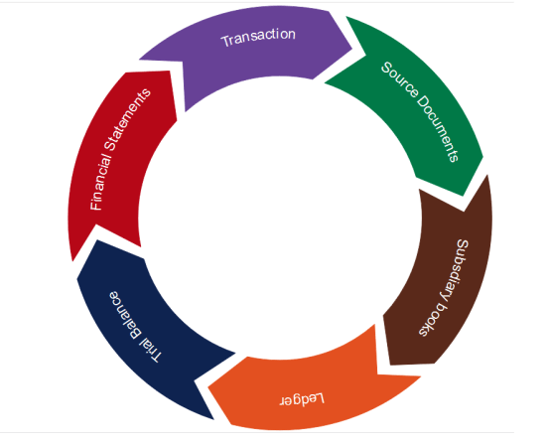
Lecture 3.
Accounting Cycle: categories of accounts, double-entry
rules

Slide 3
Learning Outcomes:
Upon successful completion of the session, students will be able …
To analyze the stages of Accounting Cycle;
To classify Categories of Accounts;
To define and identify assets, liabilities, equity, revenue and expenses;
To apply the accounting equation;
To demonstrate the use of double-entry in accounting systems.

Slide 4
Accounting Cycle
SOURCE DOCUMENTS
Transactions
(e.g. invoices, receipts)
Where original information is to be found
Classified and recorded in
ORIGINAL ENTRY
Books of Original Entry/Day Books
(list of transactions)
What happens to it
Accounting cycle refers to the sequence in which data is recorded and processed until it becomes part of the financial statements at the end of the period
Occurrence of transactions: Transactions are financial or economic events which are measurable in monetary terms and recorded in the accounting books.
Recording of these transactions in journals or books of original entry – examples of books of original entry are sales journals, purchase journals, cash book.

Slide 5
Accounting Cycle
ORIGINAL ENTRY
Books of Original Entry/Day Books
(list of transactions)
What happens to it
Posted to
DOUBLE ENTRY
Ledgers
(debits and credits)
How the dual aspect of each transaction is recorded
Transferring or “posting” of the entries from the journals to the ledger accounts or ledger. The ledger account is a form of record used to record increases and decreases in a single item. In the ledger accounts, the items are separated and classified.
Balancing off the accounts in the ledger/s at the end of the accounting period to determine debit or credit balances.
Making end of the period adjustments – for example, the recording of depreciation as an expense at the end of the accounting period.

Slide 6
General Journal
Date | Entry | Accounts and Explanation | Post Ref | Debit | Credit
2020 | 1 | Cash | 100 | 400 000
Jan 2 |  | Paid-in capital | 300 |  | 400 000
 |  | Capital stock issued to Lopez
2020 | 2 | Cash | 100 | 100 000
Jan 2 |  | Note payable | 202 |  | 100 000
 |  | Borrowed at 9% interest on a one year note
2020 | 3 | Store equipment | 170 | 15 000
Jan 3 |  | Cash | 100 |  | 15 000
 |  | Acquired store equipment for cash

Slide 7
General Ledger
Cash Account No. 100
Date | Explanation | Journ. Ref. | Debit | Date | Explanation | Journ.Ref. | Credit
2020 1/2 | (often blank because the explanation is already in the journal | 1 | 400 000 | 2020 1/3 |  | 3 | 15 000
2020 1/2 |  | 2 | 100 000
Store equipment Account No. 170
Date | Explanation | Journ. Ref. | Debit | Date | Explanation | Journ.Ref. | Credit
2020 1/3 |  | 3 | 15 000
Note payable Account No. 202
Date | Explanation | Journ. Ref. | Debit | Date | Explanation | Journ.Ref. | Credit
 |  |  |  | 2020 1/2 |  | 2 | 100 000
Paid-in Capital Account No. 300
Date | Explanation | Journ. Ref. | Debit | Date | Explanation | Journ.Ref. | Credit
 |  |  |  | 2020 1/2 |  | 1 | 400 000

Slide 8
Posting transactions to the General Ledger
Cash Account No. 100
Date | Explanation | Journ. Ref. | Debit | Credit | Balance
2020 | (often blank because the explanation is already in the journal
1/2 |  | 1 | 400 000 |  | 400 000
1/2 |  | 2 | 100 000 |  | 500 000
1/3 |  | 3 |  | 15 000 | 485 000

Slide 9
Accounting Cycle
DOUBLE ENTRY
How the dual aspect of each transaction is recorded
Ledgers
(debits and credits)
Checked by
CHECK ARITHMETIC
Trial Balance
(summary of debits and credits)
Checking the arithmetical accuracy
P&L
Profit and Loss Account (performance of entity)
Calculating P or L for the period
Preparing the trial balance – to prove the equality of debit and credit balances in the ledger.
Preparing the financial statements – the profit and loss account, the balance sheet, cash flow statement

Slide 10
Trial Balance, January 3,2020
Account Number | Account Title | Debit | Credit
100 | Cash | $485 000,00
170 | Store Equipment | $15 000,00
202 | Note payable |  | $100 000,00
300 | Paid-in Capital |  | $400 000,00
 | Total | $500 000,00 | $500 000,00

Slide 11
Accounting Cycle
P&L
Profit and Loss Account (performance of entity)
Calculating P or L for the period
CLOSING FINANCIAL POSITION
Balance Sheet
(financial position)
Closing the accounts – only the revenue and expense accounts will be closed.
Audit – after which the accounting cycle process repeats itself for a new accounting period.

Slide 12
Accounting Cycle
SOURCE DOCUMENTS
Transactions
(e.g. invoices, receipts)
Classified and recorded in
Books of Original Entry/Day Books
(list of transactions)
ORIGINAL ENTRY
Posted to
DOUBLE ENTRY
Ledgers
(debits and credits)
Checked by
CHECK ARITHMETIC
Trial Balance
(summary of debits and credits)
Profit and Loss Account (performance of entity)
P&L
CLOSING FINANCIAL POSITION
Balance Sheet
(financial position)

Slide 13

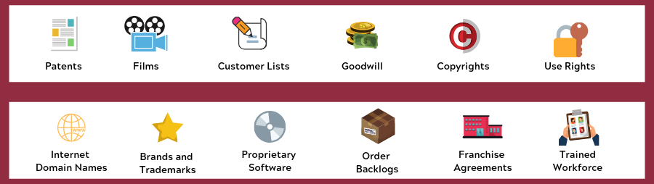
Assets
Assets are possessions or resources OWNED by an entity.
They include physical or tangible possessions such as property, plant, machinery, stock, cash and bank balances.
  They also include intangible assets, i.e. such as copyright , franchise and patent rights

Slide 14
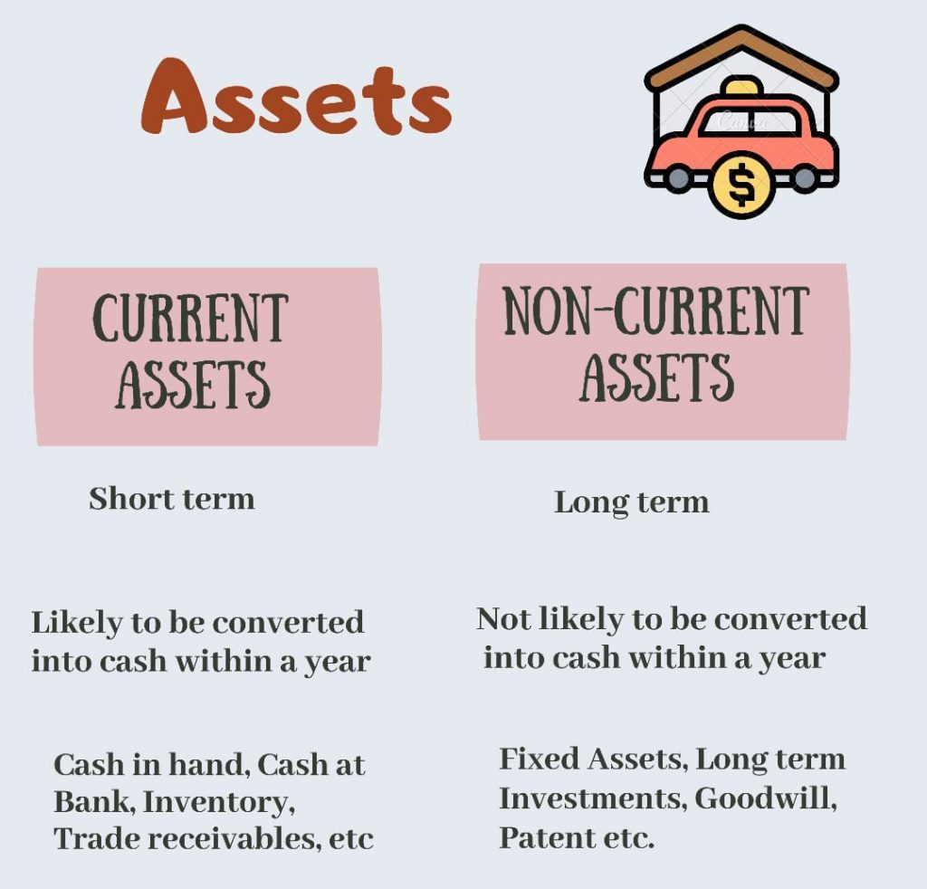

Slide 15
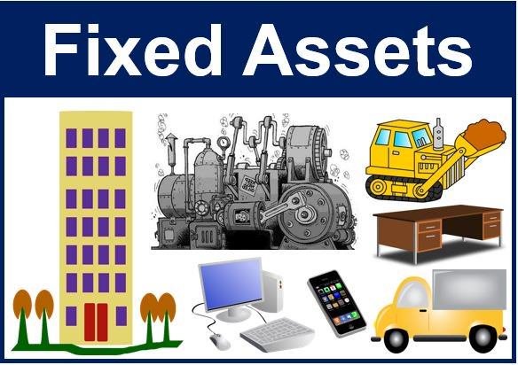
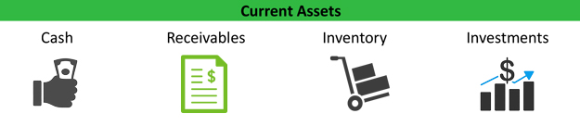
Categories of Assets
FIXED ASSETS | TANGIBLE
 | INTANGIBLE
 | FINANCIAL
CURRENT ASSETS | CASH
 | STOCK
 | DEBTORS
 | PREPAYMENTS
 | INVESTMENTS

Slide 16

Liabilities
Liabilities
are the amounts OWED by an entity to outside parties.
They include loans, bank overdrafts, creditors, i.e. amounts owing to parties for the supply of goods and services to the entity that have not yet been settled in cash.

Slide 17
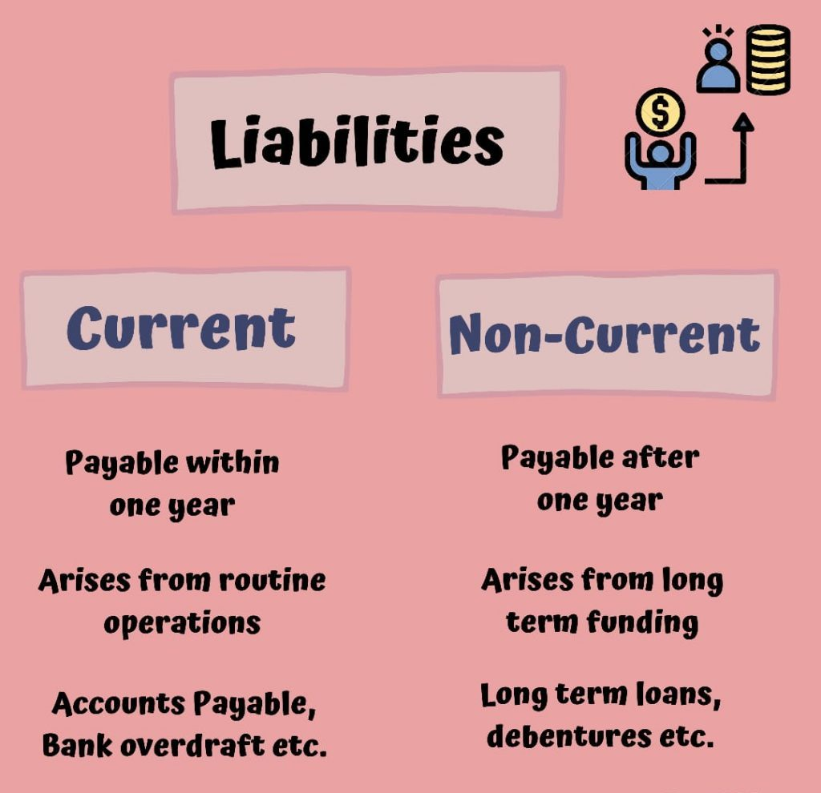
Liabilities

Slide 18
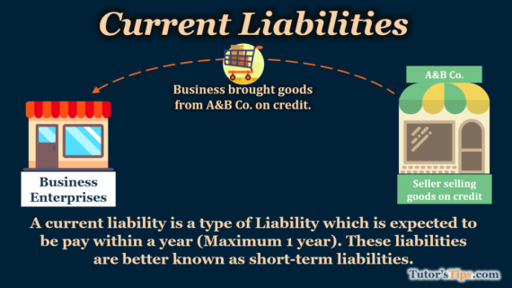
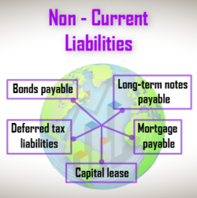
Categories of Liabilities
SHORT-TERM (CURRENT) | BANK OVERDRAFT
 | ACCOUNTS PAYABLE
 | ACCRUED TAX
 | PAYROLL
 | CURRENT PORTION OF LONG-TERM DEBT
LONG -TERM | BOND
 | MORTGAGE
 | DEBENTURE

Slide 19
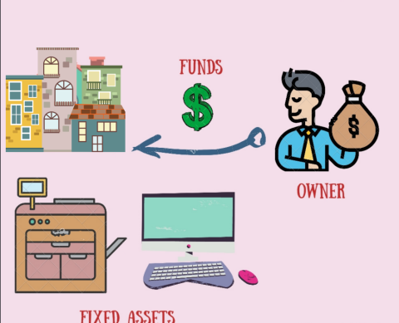
Capital
Capital comprises the funds invested in the business by the owner plus any profits retained for use in the business less any share of profits paid out of the business to the owner.
Capital is often called the owner’s equity or net worth.
In the case of corporations, capital can be in the form of common shares, preferred shares, retained profit or reserves.

Slide 20

Revenues
Turnover (sales)
Profits on sale of fixed assets
Interest receivable
Investment income
Discounts received
Share of profit from associated companies

Slide 21
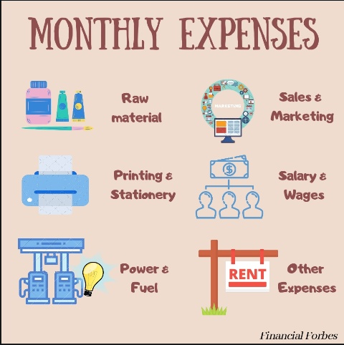
Expenses
Expenses are usually seen as being the costs incurred in earning the revenues that are recognized during that period
Cost of Sales (COGS)
Depreciation
Losses from the sale of fixed assets
Discounts allowed
Increase in provision

Slide 22
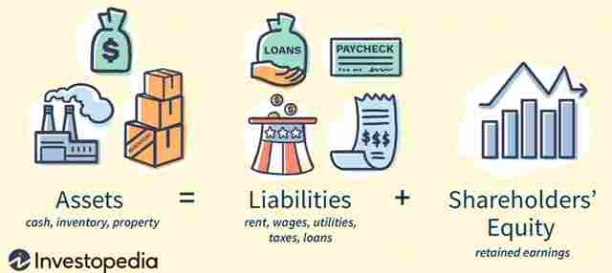

Accounting Equation
Double-entry bookkeeping is governed by the accounting equation. At any point in time, the following equation must hold true: “What business owns, it owes”
Example:
John invested $5000 cash in his business. The cash is an asset and the investment is John’s business’ capital.
ASSETS
CAPITAL
=
Cash $5000
Capital $5000

Slide 23
Accounting Equation
Example:
Then, he borrowed $2,000 from Edward for his business.
He purchased goods for cash of $1000
ASSETS
CAPITAL
LIABILITIES
=
+
Cash $7000
Capital $5000
Loan from Edward $2000
ASSETS
CAPITAL
LIABILITIES
=
+
Cash and goods
$6000 + $1000
Capital $5000
Loan from Edward $2000

Slide 24
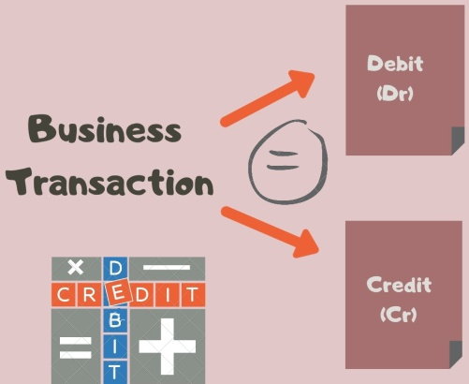
Debit and Credit
From the previous examples, if an adjustment is made to one side of the equation, you must make an identical adjustment either to other side of the equation or to the same side.
Accountants use the term debit (Dr) to denote an entry or balance on the left side of any account and the term credit (Cr) to denote an entry or balance on the right side. In accounting debit and credit mean simply left-side entry and right- side entry
Notes:
How do we show the effect.

Slide 25
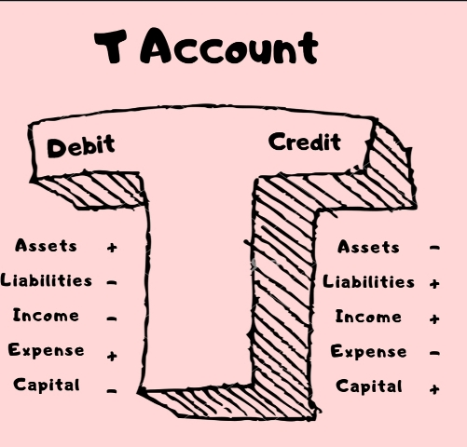
Double entry
An account is a place where all the information referring to a particular asset, liability, or capital, is recorded
The layout of a page of an account book:
Title of an account written here
DEBIT | CREDIT

Slide 26
Transaction analysis
Beginners may find this useful before recording the entries in the journals / ledgers.
The following steps are involved:
1.Determine the two accounts affected / involved.
2.Classify the two accounts according to the 5 elements identified as above.
3.Determine whether there is an increase or decrease in each of the two accounts.
4.Record the entries in the books of account according to the double-entry rules.

Slide 27
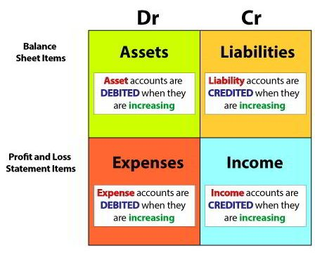
Debit and Credit affects
 | DEBIT | CREDIT
ASSETS | + | -
LIABILITIES | - | +
CAPITAL | - | +
REVENUES | - | +
EXPENSES | + | -
Notes:
To increase an asset –debit entry
To decrease an asset – credit entry
To increase liability/capital – credit entry

Slide 28
For every debit entry there must be credit entry
AND
For every credit entry there must be debit entry

Slide 29
Examples
 | Dr |  | Cr
Transaction | Name of A/c | Type of A/c | Name of A/c | Type of A/c
John started business with $1000 and he deposited it into the business’ bank account
John paid rent amounting to $200 by cash

Slide 30
Lecture Roundup:
Ledger accounts summarize all the individual transactions listed in the books of prime entry.
The journal is the record of prime entry for transactions which are not recorded in any of the other books of prime entry.
The accounting equation is ASSETS = CAPITAL + LIABILITIES.
Trade accounts payable are liabilities. Trade accounts receivable are assets.
Double entry bookkeeping is based on the idea that each transaction has an equal but opposite effect. Every accounting event must be entered in ledger accounts both as a debit and as an equal but opposite credit.

Slide 31
6. A debit entry will:
– Increase an asset
– Decrease a liability
– Increase an expense
A credit entry will:
– Decrease an asset
– Increase a liability
– Increase income

Slide 32
Homework
Compare and contrast between revenue expenditure and capital expenditure.
2. What are the following accounts used for (i) capital; (ii) trade creditors; (iii) trade debtors; (iv) stock; (v) sales; (vi) purchases; and (vii) drawings?

Slide 33
References
Dyson, J.R (2004) Accounting for Non-Accounting Students, chapter 3.
Wood, F & Sangster, A (2001) Business Accounting 1, chapters 1-2
ACCA (2017) Approved Interactive Text. Foundations in Accountancy FFA 2017/2018. BPP Media Ltd.
Horngren (2014) Introduction to Financial Accounting, chapter 3

